Slide 1
Applying Collective Impact to a Healthy Start CAN/CI Initiative
Peer Learning Network Call #7
Action Planning & Continuous Communication
December 2015

Slide 2
Agenda
Welcome
Objectives
Check-In
Wrap –In
Action Planning
Review Template
Overview of Continuous Communication
Wrap-up & Next Steps

Slide 3
Roadmap
Session | Monthly Call Focus
1 | Building Relationships & PLN Goal Setting
2 | Exploring the CI Pre-Conditions
3 | Common Agenda
4 | Shared Measurement
5 | Mutually Reinforcing Activities
6 | Year 1 Collective Impact - Action Plans (Face to Face!)
7 | Recap Action Planning & Continuous Communications
8 | Backbone Function & Reflecting On Our Learning Journey

Slide 4
Objectives
Review/recap optional CAN/CI Initiative Action Plan template
Share goals and/or activities to move CAN/CI Initiative forward
Increase understanding and share examples of continuous communication
Introduce and discuss tool that will help CAN/CI Initiatives begin to explore this condition

Slide 5
Creating a Safe Space
We agree to:
Listen with attention
Speak with intention
Contribute to the well-being of the group
We commit to:
Keep the stories we share in our community confidential
Listening with compassion and curiosity
Asking each other for what we need and offer what we can
Pausing, from time to time, to re-gather our thoughts or focus

Slide 6
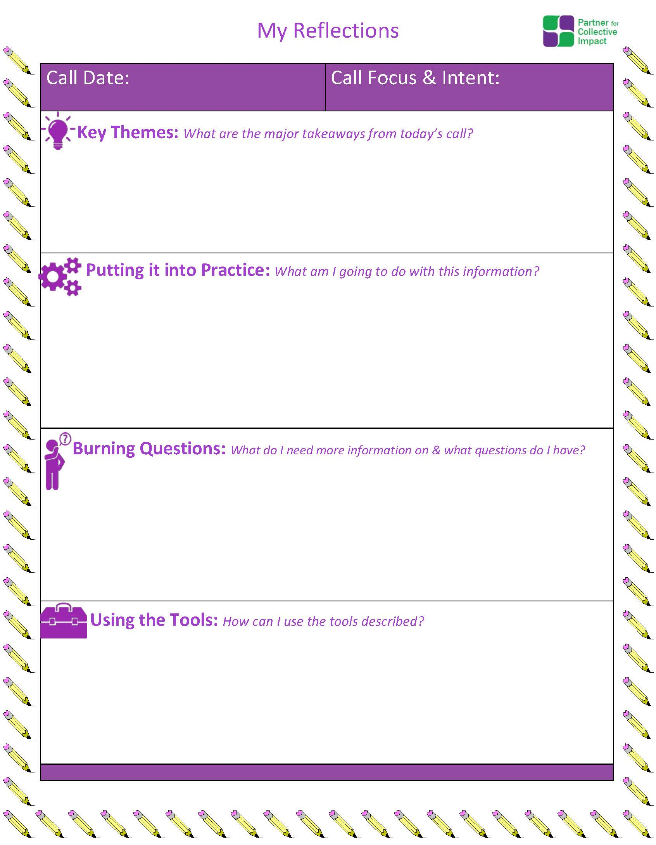
Reminder: Post Call Reflection Tool

Slide 7
Check – In
What are you most proud of as it relates to your CAN/CI Initiative when you reflect over the past year?

Slide 8
Community Action Network – Action Plan Template
Optional Planning Template/Tool

Slide 9
Check – In
Who attended the “Live” CI-PLN session in November?
What questions remain regarding the planning template presented?

Slide 10
About the CAN Action Plan Template/Tool
Template is optional
Purpose is to consider progress to date and plan for the next 12 months
Organize and think through your CAN/CI efforts
With the help of Tamarack, the CI-PLN Co-Facilitators adapted FSG’s Phases of Collective Impact document and then used that as a frame for the template
We are interested in hearing your feedback and suggestions as you use the template. Just as CI is adaptive, so is the template
Communicating your CI Journey

Slide 11
FSG’s Phases with Tamarack’s Additions

Slide 12
The Phases of Collective Impact
Over-arching Actions | Components of Success | Phase I Generate Ideas and Host Dialogues | Phase II Initiate Action | Phase III Organize for Impact | Phase IV Sustain Action and Impact
 |  | Pre start-up Focus: Engagement and Exploration | Start up Focus: From Idea to Formation | Growth Focus: Experimentation and Growth | Maturity Focus: Sustain and Renew
 |  | EARLY YEARS Key Question: What needs to happen? |  | MIDDLE YEARS Key Question: How well is it working? | LATER YEARS Key Question: What difference are we making?
 |  | KEY ELEMENTS
Design, Implement and Lead your CI Initiative | Governance and Infrastructure How decisions are made and responsibilities shared | Convene Community Stakeholders | Identify champions and form cross-sector group | Create infrastructure (backbone and processes) | Facilitate, refine and renew
 | Strategic Planning What are we trying to do and how: Our Theory of Change | Hold dialogue about issue, community context and available resources | Map the landscape and use data to make the case | Create common agenda (shared goals and strategy) | Support implementation (alignment to goal and strategies)
Understand Context | Community Involvement Who is involved? Who else’s eyes need to be on this issue? | Facilitate community outreach specific to goal | Facilitate community outreach | Engage community and build public will | Continue engagement and conduct advocacy
Assess Progress, Outcomes, Impact and Learning | Evaluation and Improvement What are we learning and how are we changing culture, norms and systems? | Determine if there is consensus and urgency to move forward | Analyze baseline data to ID key issues and gaps | Establish shared metrics (indicators, measurement and approach) | Collect, track and report progress (process to learn and improve)

Slide 13
The Phases of Collective Impact
Over-arching Actions | Components of Success | Phase I Generate Ideas and Host Dialogues | Phase II Initiate Action | Phase III Organize for Impact | Phase IV Sustain Action and Impact
 |  | Pre start-up Focus: Engagement and Exploration | Start up Focus: From Idea to Formation | Growth Focus: Experimentation and Growth | Maturity Focus: Sustain and Renew
 |  | EARLY YEARS Key Question: What needs to happen? |  | MIDDLE YEARS Key Question: How well is it working? | LATER YEARS Key Question: What difference are we making?
 |  | KEY ELEMENTS
Design, Implement and Lead your CI Initiative | Governance and Infrastructure How decisions are made and responsibilities shared | Convene Community Stakeholders | Identify champions and form cross-sector group | Create infrastructure (backbone and processes) | Facilitate, refine and renew
 | Strategic Planning What are we trying to do and how: Our Theory of Change | Hold dialogue about issue, community context and available resources | Map the landscape and use data to make the case | Create common agenda (shared goals and strategy) | Support implementation (alignment to goal and strategies)
Understand Context | Community Involvement Who is involved? Who else’s eyes need to be on this issue? | Facilitate community outreach specific to goal | Facilitate community outreach | Engage community and build public will | Continue engagement and conduct advocacy
Assess Progress, Outcomes, Impact and Learning | Evaluation and Improvement What are we learning and how are we changing culture, norms and systems? | Determine if there is consensus and urgency to move forward | Analyze baseline data to ID key issues and gaps | Establish shared metrics (indicators, measurement and approach) | Collect, track and report progress (process to learn and improve)

Slide 14
The Phases of Collective Impact
Over-arching Actions | Components of Success | Phase I Generate Ideas and Host Dialogues | Phase II Initiate Action | Phase III Organize for Impact | Phase IV Sustain Action and Impact
 |  | Pre start-up Focus: Engagement and Exploration | Start up Focus: From Idea to Formation | Growth Focus: Experimentation and Growth | Maturity Focus: Sustain and Renew
 |  | EARLY YEARS Key Question: What needs to happen? |  | MIDDLE YEARS Key Question: How well is it working? | LATER YEARS Key Question: What difference are we making?
 |  | KEY ELEMENTS
Design, Implement and Lead your CI Initiative | Governance and Infrastructure How decisions are made and responsibilities shared | Convene Community Stakeholders | Identify champions and form cross-sector group | Create infrastructure (backbone and processes) | Facilitate, refine and renew
 | Strategic Planning What are we trying to do and how: Our Theory of Change | Hold dialogue about issue, community context and available resources | Map the landscape and use data to make the case | Create common agenda (shared goals and strategy) | Support implementation (alignment to goal and strategies)
Understand Context | Community Involvement Who is involved? Who else’s eyes need to be on this issue? | Facilitate community outreach specific to goal | Facilitate community outreach | Engage community and build public will | Continue engagement and conduct advocacy
Assess Progress, Outcomes, Impact and Learning | Evaluation and Improvement What are we learning and how are we changing culture, norms and systems? | Determine if there is consensus and urgency to move forward | Analyze baseline data to ID key issues and gaps | Establish shared metrics (indicators, measurement and approach) | Collect, track and report progress (process to learn and improve)

Slide 15
The Phases of Collective Impact
Over-arching Actions | Components of Success | Phase I Generate Ideas and Host Dialogues | Phase II Initiate Action | Phase III Organize for Impact | Phase IV Sustain Action and Impact
 |  | Pre start-up Focus: Engagement and Exploration | Start up Focus: From Idea to Formation | Growth Focus: Experimentation and Growth | Maturity Focus: Sustain and Renew
 |  | EARLY YEARS Key Question: What needs to happen? |  | MIDDLE YEARS Key Question: How well is it working? | LATER YEARS Key Question: What difference are we making?
 |  | KEY ELEMENTS
Design, Implement and Lead your CI Initiative | Governance and Infrastructure How decisions are made and responsibilities shared | Convene Community Stakeholders | Identify champions and form cross-sector group | Create infrastructure (backbone and processes) | Facilitate, refine and renew
 | Strategic Planning What are we trying to do and how: Our Theory of Change | Hold dialogue about issue, community context and available resources | Map the landscape and use data to make the case | Create common agenda (shared goals and strategy) | Support implementation (alignment to goal and strategies)
Understand Context | Community Involvement Who is involved? Who else’s eyes need to be on this issue? | Facilitate community outreach specific to goal | Facilitate community outreach | Engage community and build public will | Continue engagement and conduct advocacy
Assess Progress, Outcomes, Impact and Learning | Evaluation and Improvement What are we learning and how are we changing culture, norms and systems? | Determine if there is consensus and urgency to move forward | Analyze baseline data to ID key issues and gaps | Establish shared metrics (indicators, measurement and approach) | Collect, track and report progress (process to learn and improve)

Slide 16
The Phases of Collective Impact
Over-arching Actions | Components of Success | Phase I Generate Ideas and Host Dialogues | Phase II Initiate Action | Phase III Organize for Impact | Phase IV Sustain Action and Impact
 |  | Pre start-up Focus: Engagement and Exploration | Start up Focus: From Idea to Formation | Growth Focus: Experimentation and Growth | Maturity Focus: Sustain and Renew
 |  | EARLY YEARS Key Question: What needs to happen? |  | MIDDLE YEARS Key Question: How well is it working? | LATER YEARS Key Question: What difference are we making?
 |  | KEY ELEMENTS
Design, Implement and Lead your CI Initiative | Governance and Infrastructure How decisions are made and responsibilities shared | Convene Community Stakeholders | Identify champions and form cross-sector group | Create infrastructure (backbone and processes) | Facilitate, refine and renew
 | Strategic Planning What are we trying to do and how: Our Theory of Change | Hold dialogue about issue, community context and available resources | Map the landscape and use data to make the case | Create common agenda (shared goals and strategy) | Support implementation (alignment to goal and strategies)
Understand Context | Community Involvement Who is involved? Who else’s eyes need to be on this issue? | Facilitate community outreach specific to goal | Facilitate community outreach | Engage community and build public will | Continue engagement and conduct advocacy
Assess Progress, Outcomes, Impact and Learning | Evaluation and Improvement What are we learning and how are we changing culture, norms and systems? | Determine if there is consensus and urgency to move forward | Analyze baseline data to ID key issues and gaps | Establish shared metrics (indicators, measurement and approach) | Collect, track and report progress (process to learn and improve)

Slide 17
CAN/CI Action Plan for: Community Involvement

Slide 18
Supplemental Tool: Assessing Our Progress
Component of Success:
Our strengths and achievements to date: | What are our current priorities? | What do we need to plan for next?
 |  | 1.
2. | 2. | 2.
3. | 3. | 3.
4. | 4. | 4.
5. | 5. | 5.
6. | 6. | 6.
7. | 7. | 7.
What can we stop doing now? | What do we need to continue? | What new things need to be added?
2. | 2. | 2.
3. | 3. | 3.
4. | 4. | 4.
5. | 5. | 5.
6. | 6. | 6.
7. | 7. | 7.

Slide 19
Group Discussion
Have you or do you plan on engaging in a CAN/CI planning process?
Who do you involve in your planning process?
Do you have a planning template that you use?
What are your thoughts about the template just presented?
If you have already begun a planning process, please share a goal or activity you have identified?

Slide 20
Overview of Continuous Communication

Slide 21
The Five Conditions of Collective Impact
Common Agenda
All participants have a shared vision for change including a common understanding of the problem and a joint approach to solving it through agreed upon actions
Shared Measurement
Collecting data and measuring results consistently across all participants ensures efforts remain aligned and participants hold each other accountable
Mutually Reinforcing Activities
Participant activities must be differentiated while still being coordinated through a mutually reinforcing plan of action
Continuous Communication
Consistent and open communication is needed across the many players to build trust, assure mutual objectives, and appreciate common motivation
Trust * Transparency * Ongoing * Engaging
Backbone Support
Creating and managing collective impact requires a dedicated staff and a specific set of skills to serve as the backbone for the entire initiative and coordinate participating organizations and agencies
11
Source: FSG

Slide 22
Continuous Communication
Establishing informal and formal mechanisms for keeping people informed about the progress of CI effort

Slide 23
Elements of Continuous Communications Strategy
Establishing structures and practices to communication amongst and between CI partners – including discussion of difficult issues
Considering each partner’s needs and ability to communicate the CI work with their own organizations and networks
Strategies to keep the public informed and engaged in the CI work

Slide 24
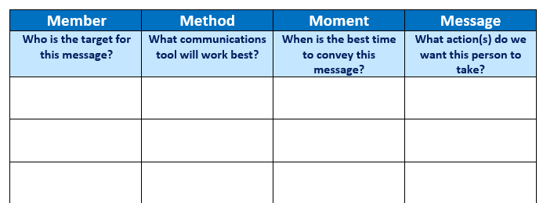
Continuous Communication Tool: The 4 “M”s

Slide 25
Group Discussion
What methods/techniques do you use to ensure continuous communication with your stakeholders?

Slide 26
Next Steps & Wrap Up
Reminder: If you would like more individualized TA related to your CAN or CI Initiative please visit the Healthy Start EPIC website to submit a TA request.
In-person CI PLN celebration at the NHSA Spring Conference on Sunday evening from 5-6:30pm
Next Call: Backbone Function & Reflecting on our Learnings – questions to be sent in advance for sharing

Slide 27
Next Steps – What are your thoughts?
As we wrap up the 1st CI-PLN series we are considering next steps.
What would you find helpful moving forward?

Slide 28
What’s your word?
Please chat in a word that best describes today’s call.

Slide 29
Next CI PLN Call: Backbone Function & Reflections and Lessons Learned January 2016

