Slide 1
Applying Collective Impact to a Healthy Start CAN/CI Initiative
Peer Learning Network Call #1
June 2015

Slide 2
Agenda
Introductions
Glimpse Into Our PLN Community
Laying the groundwork for our PLN
Collective Impact Overview & Discussion
Reflective Activity: Assessing Community Context
Between Now & Then (aka next call)
Closing

Slide 3
About YOU!
Please share your name and length of time you have been with
your HS project.
We are going to share in alphabetical order according to the registration information:
We will start with AL, then CA, CO, CT, DC, FL, IL, LA, MD, MI, MO, MS, NC, NE, NJ, NM, NV, NY, OH, OK, PA, SC, TN, TX, VA.. Others that we missed
Reminder: Press *6 to unmute your lines. Then either press *6 to mute your line or your mute button on your phone

Slide 4
Our Objectives
Develop a deeper understanding of CI
Learn about tools that can assist with applying the five CI conditions
Develop a CI action plan
Engage in peer sharing and exchange with respect to CI successes and challenges within the HS context

Slide 5
Key Deliverables:
(by Jan 2016)
Each Grantee will share a 1 Year, CI Implementation Plan using a template that is provided.
Each Peer Learning Network will:
Document and share highlights, insights and learnings from their network
Share any resources and tools developed by their network
Identify Learning Needs and supports for the next phase of work

Slide 6
CI-PLN Roadmap
Session | Monthly Call Focus
1 | Building Relationships & PLN Goal Setting
2 | Exploring the CI Pre-Conditions
3 | Common Agenda
4 | Shared Measurement
5 | Mutually Reinforcing Activities
6 | Continuous Communications & Backbone Infrastructure
7 | Year 1 Collective Impact Implementation Plans
8 | Reflecting On Our Learning Journey

Slide 7
Creating a Safe Space
We agree to:
Listen with attention
Speak with intention
Contribute to the well-being of the group
We commit to:
Keep the stories we share in our community confidential
Listening with compassion and curiosity
Asking each other for what we need and offer what we can
Pausing, from time to time, to re-gather our thoughts or focus

Slide 8
Peer Learning Networks
What do you think of when you hear “Peer Learning Networks”?

Slide 9
Collective Impact Overview & Discussion
Slides Adapted from
Sylvia Cheuy
Director
Tamarack Institute

Slide 10
Things to consider as we provide the overview…
Who from my team or stakeholders would benefit from this information?
What would make me feel more confident presenting a CI Overview to my team and/or stakeholders?
Where does my CAN fall on the CI Spectrum?
Where would I like us to be one year from now?
Do I need (new) champion(s) to accomplish this?
If so, how can I start to engage them in a meaningful way?
Other resources:
1) Link to Sylvia Cheuy’s presentation from the Convention (November 2014)
Link to Sylvia Cheuy’s presentation from the EPIC Center’s CI Webinar (February 2015)

Slide 11
The Collaboration Spectrum
Trust
Compete | Co-exist | Communicate | Cooperate | Coordinate | Collaborate | Integrate
Competition for clients, resources, partners, public attention. | No systematic connection between agencies. | Inter-agency information sharing (e.g. networking). | As needed, often informal, interaction, on discrete activities or projects. | Organizations systematically adjust and align work with each other for greater outcomes. | Longer term interaction based on shared mission, goals; shared decision-makers and resources. | Fully integrated programs, planning, funding.
Turf
Loose
Tight

Slide 12
A Definition of Collective Impact
“A disciplined, cross-sector approach to solving complex social and environmental issues on a large scale.”
- FSG: Social Impact Consultants

Slide 13
Pre-conditions for Collective Impact
Influential Champion(s)
Urgency of issue
Adequate Resources

Slide 14
The Five Conditions of Collective Impact
Common Agenda
All participants have a shared vision for change including a common understanding of the problem and a joint approach to solving it through agreed upon actions
Collecting data and measuring results consistently across all participants ensures efforts remain aligned and participants hold each other accountable
Participant activities must be differentiated while still being coordinated through a mutually reinforcing plan of action
Consistent and open communication is needed across the many players to build trust, assure mutual objectives, and appreciate common motivation
Creating and managing collective impact requires a dedicated staff and a specific set of skills to serve as the backbone for the entire initiative and coordinate participating organizations and agencies
Shared Measurement
Mutually Reinforcing Activities
Continuous Communication
Backbone Support
11
Source: FSG

Slide 15
Collective Impact & Healthy Start
Common Agenda | Shared Measurement | Mutually Reinforcing Activities | Continuous Communication | Backbone Organization
Improve Perinatal outcomes Reduce racial and ethnic disparities Use community-based approaches to service delivery Facilitate access to comprehensive health and social services for women, infants and their families | Achieve Healthy Start Benchmarks Measurement Process and Approach | Improve Women’s Health Promote Quality Services Strengthen Family Resilience Achieve Collective Impact Increase Accountability | Audiences Media | Coordination Facilitation Administrative Support

Slide 16
Collective Impact – Framing Questions
Do we aim to effect―needle- change (i.e., significant and measurable progress) on a community-wide metric?
Do we believe that a long-term investment (i.e., three to five-plus years) by stakeholders is necessary to achieve success?
Do we believe that cross-sector engagement is essential for community-wide change?
Are we committed to using measurable data to set the agenda and improve over time?
Are we committed to having community members as partners and producers of impact?

Slide 17
Phases of Collective Impact
Source: FSG Social Impact Consultants

Slide 18
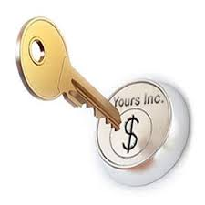
Collective Impact Mindset Shift
From Buy-In
To Ownership

Slide 19
Group Discussion
What are your thoughts about this definition of buy-in and ownership?

Slide 20
Collective Impact Mindset Shift
From Programs
To Systems

Slide 21
Group Discussion
What strategies are you employing to ensure that your CAN/CI initiative is addressing systems change vs. program outcomes?

Slide 22
Collective Impact Mindset Shift
From Positional Leadership
To Shared & Adaptive Leadership

Slide 23
Group Discussion
In what ways are you using a shared or adaptive leadership approach?

Slide 24
Questions & Reflections?
Questions?
Thoughts or reflections?

Slide 25
Reflective Activity: Assessing Community Context
Condition | What is challenging about this condition for our community? | Ideas for filling the gaps
History of Collaboration
Influential Leaders
Urgent Issues in Your Community
How Does Your Work Fit Into the Urgent Issues
Adequate Resources
What is unique about our community that we have to pay attention to?
(Past history of collaboration, interest in the issue, key leadership, etc.)
How does the community context influence our community issue?

Slide 26
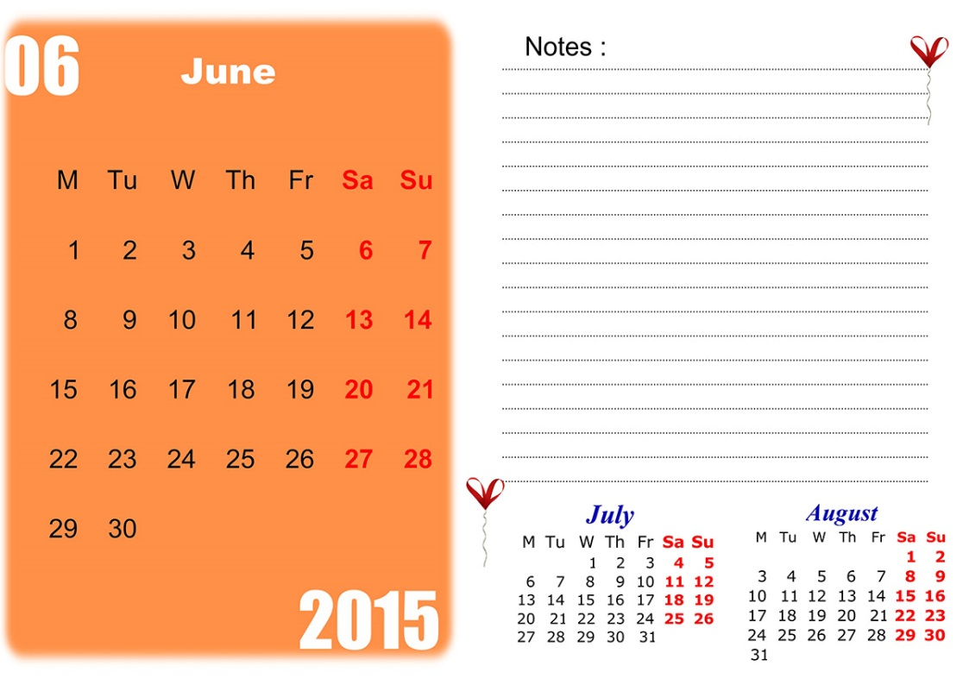
Between Now & Then (aka next call)
Register and share profile info on forum
See slides 25 - 34
Start or respond to a discussion thread on the forum
Adapt CI 101 Slides for your audience an give presentation (to staff or CAN members)
Sample slides will be emailed following call
(If applicable) Complete the Reflective Activity: Assessing Community Context
Tool will be emailed following call

Slide 27
Next CI PLN Call: July 2015

